Slide 1


LTE Network Anomaly Detection

Slide 2

Team Members
1
Ahmed Hossam Arfaa
2
Hager Mohamed Fawzy
3
Khaled Tarek Ghazala
💼 Supervising Team:
Dr: Mahmoud Abdel Aziz
Eng: Mariham Rizk
4
A'laa Khaled Samir
5
Marwa Shaaban Abd Elhakim

Slide 3
Agenda
Introduction & Motivation
1
2
Challenges & System Description
3
Dataset & Feature Engineering
4
Anomaly Detection Module
5
LLM Summary + Geo-Spatial Module
6
Live NetVision

Slide 4
Motivation
01

Slide 5


Slide 6


Slide 7


Slide 8
Anomaly Detection
01

Slide 9

Meaning of Anomaly detection
The process of identifying the unusual patterns
When the data deviates from the expected behavior
Detecting sudden changes in KPIs that may signal:
Performance degradation
misuse
faults

Slide 10
02
Challenges

Slide 11

Why is it a problem?
Hidden issues cost money
Manual monitoring doesn’t scale
Missed anomalies lead to customer complaints and revenue loss.

Slide 12
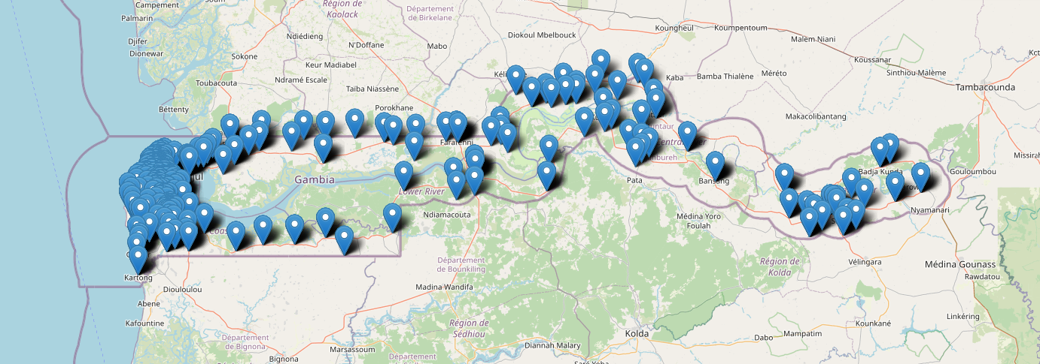
Our Purpose:
To detect anomalies in LTE network performance across Gambia for a telecom operator by analyzing a year-long dataset of LTE KPIs. An LLM-based interface allows users to query specific sites and time ranges, triggering a trained anomaly detection model to identify abnormal behavior.

Slide 13
02
System Modules

Slide 14
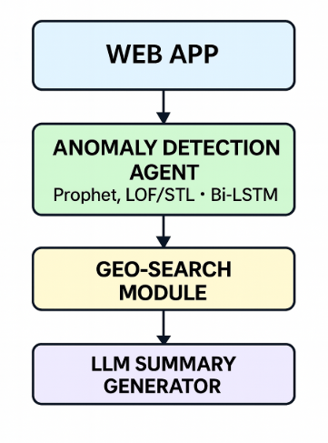
Procedures :
To build our models we divide it into 4 main parts :

Slide 15
03
Dataset & Feature Engineering

Slide 16
1.Dataset Description (Raw State):
File 1: Capacity Related KPIs.xlsx
main time-series data file with daily LTE KPIs per cell.
Key Columns:
begintime: Date (daily granularity)
Cell_Name: Unique cell identifier
ne_name, ne_type, vendor, integrity: Network metadata (equipment info)
L.RRC.ConnReq.Suc
4G DL Traffic Volume (TB)
4G DL PRB Utilization (%)
4G UL PRB Utilization (%)
4G UL Traffic Volume (TB)
raw string: Contains cell and config info in text
KPI columns:

Slide 17
File 2: EPT.xlsx:
Site/cell metadata file—static info for every site/cell.
Key Columns:
Geographic & Admin Info: Zone, District, Region, Site Name
Network Info: eNodeB Name, eNodeB ID, SITE ID, Cell name, Cell ID, Sector ID, Carrier
Geolocation: Latitude, Longitude, Azimuth
Antenna & Tower Config: Mechanical Downtilt, Electrical Downtilt, Antenna Height, Tower Height, Building Height,
Tower Type, Antenna .

Slide 18
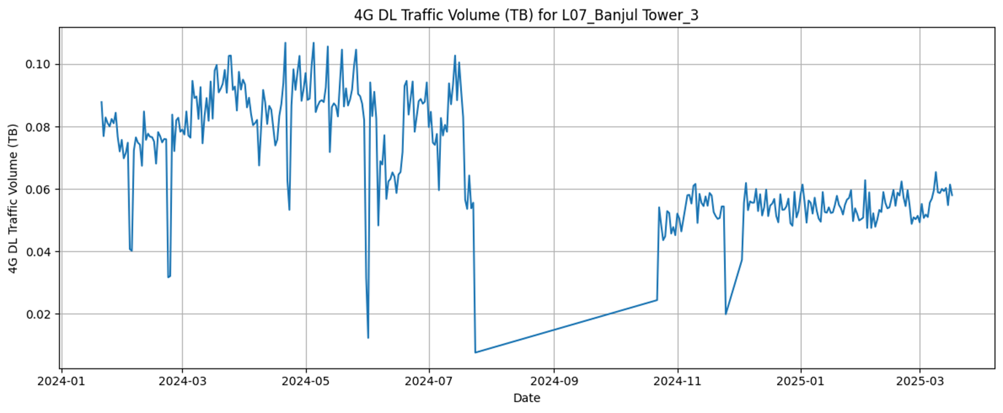
2: Initial Data Challenges
1. Pervasive Missing Data:
•Every cell (2836/2836) has missing days within the observation window .
•Missing intervals affect all cells:
•2024-07-25 to 2024-10-21 (89 days) ,2024-11-26 to 2024-12-02 (7 days)

Slide 19
Preprocessing & Cleaning Steps:
date range (2024-01-21 to 2024-07-24).
Total unique cells in date range: 1546
Cells with no missing days: 773
Cells with no missing days AND no zeros in any KPI: 720
clean data (no missing dates, no zeros in KPIs) , for further analysis and modeling.

Slide 20
Statistical Exploration of KPI Distributions:
For every cell and KPI, we analyzed the shape of the data by fitting multiple statistical distributions (e.g., logistic, GMM, t, Weibull, etc.).
If classic distributions didn’t fit well, we used Gaussian Mixture Models (GMMs) for complex or multimodal time series.
(cell, KPI) pairs that failed to fit any standard distribution were automatically flagged for further review.

Slide 21
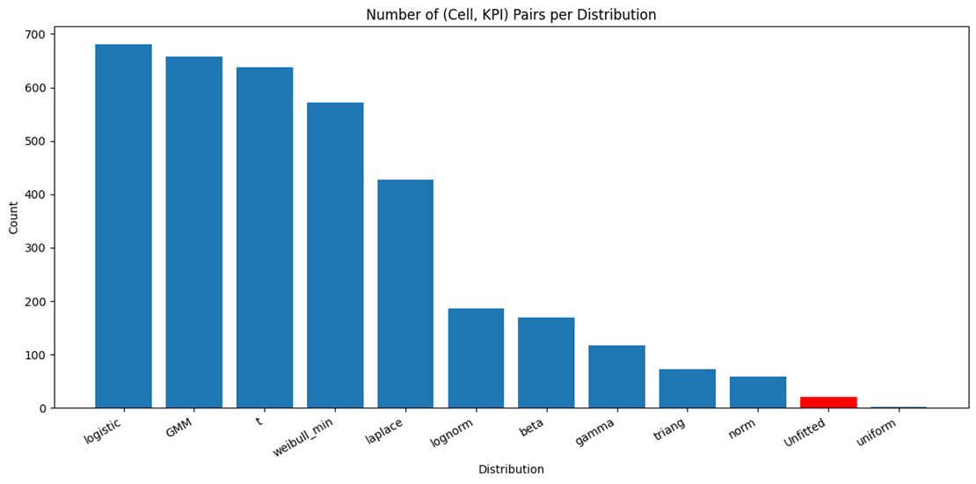
•
•
•
•
•
•
•
•
•
•
•
•
•
•
•
•
•
•
Cell/KPI pairs with NO suitable distribution: 20

Slide 22
Feature Engineering:
Motivation:
Raw KPIs alone insufficient to detect subtle or context-driven anomalies.
Temporal Features:
1.Lagged Features:
For each KPI, new columns that represent the value of that KPI at previous time steps.
Captures how the KPI was behaving, Allows the model to detect sudden jumps, drops, or reversals by comparing the current value to recent history.
2. Rolling Statistics:
are metrics calculated over a fixed-size sliding window as it moves along a time series.
[ Rolling Mean, Rolling Median, Rolling Standard Deviation, Rolling Minimum & Maximum ]
Notes:
Rolling Statistics:Help the model understand recent “normal” behavior (mean/median) and recent variability (std, min, max) E.g.: If the current KPI is way above the recent rolling mean, or far outside the rolling min/max, that could be abnormal.

Slide 23
Total Features per KPI:
1 Original column (today’s value)
2 Lagged features (lag1, lag2)
5 rolling statistics x 2 windows (3-day, 7-day):
Mean (3-day), Mean (7-day)
Median (3-day), Median (7-day)
Std (3-day), Std (7-day)
Min (3-day), Min (7-day)
Max (3-day), Max (7-day)
Total: 1 (original) + 2 (lags) + 10 (rolling) = 13 features per KPI
Starting with temporal-only features provided clarity and established a reliable anomaly detection foundation.

Slide 24
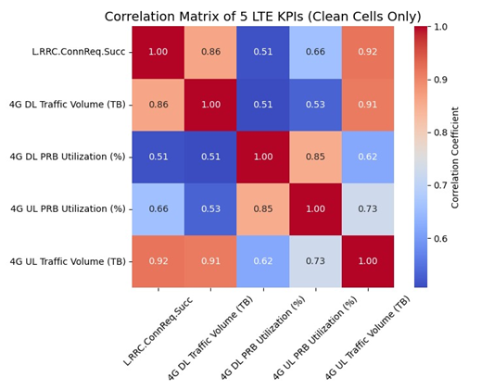
1. Geospatial Features:
•Features like latitude, longitude, distance between sites, site clustering, region, district, and zone.
2. Interaction Features:
•reflect the relationships between multiple KPIs or cells.

Slide 25
04
Anomaly Detection Module

Slide 26
Anomaly Detection Module(Global Models)
Fusion 1: Autoencoder + Prophet + LOF ((OR Combination)
Fusion 2: STL + Z-score + Prophet + LOF (OR Combination)
Fusion 3: Prophet (60%) + STL + Z-score (40%) ((Weighted Voting)

Slide 27
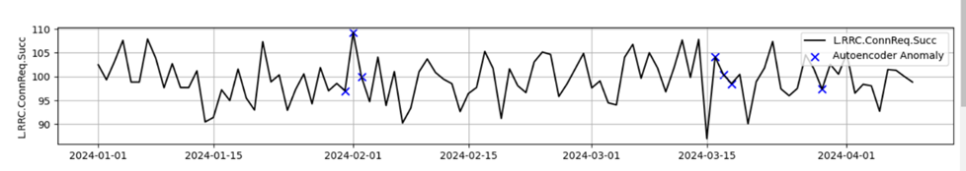
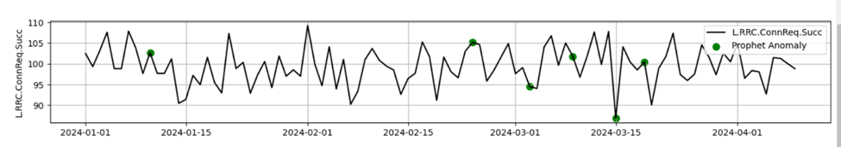
Fusion 1: Autoencoder + Prophet + LOF

Slide 28
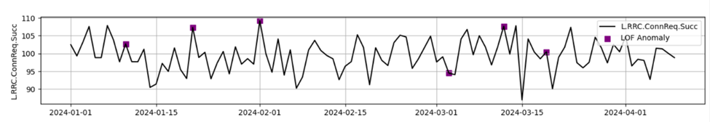
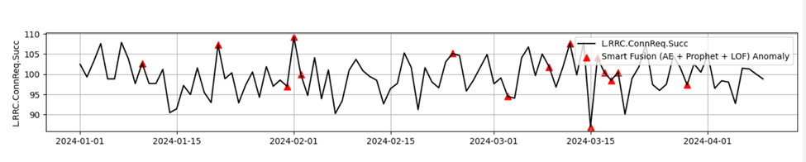
Fusion 1: Autoencoder + Prophet + LOF

Slide 29
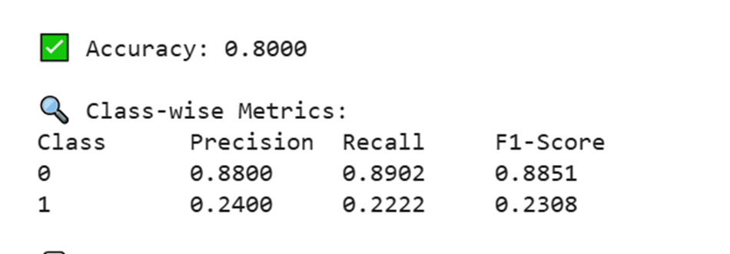
Fusion 1: Autoencoder + Prophet + LOF

Slide 30
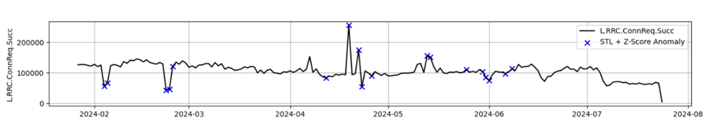
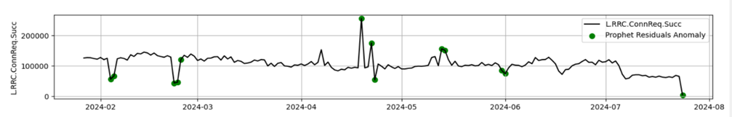
Fusion 2: STL + Z-score + Prophet + LOF

Slide 31
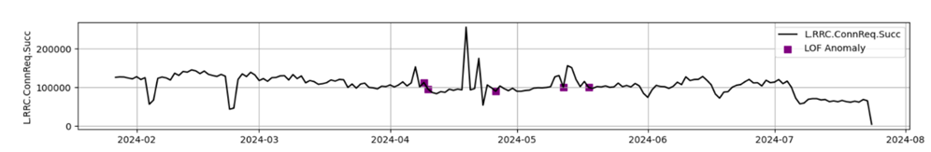
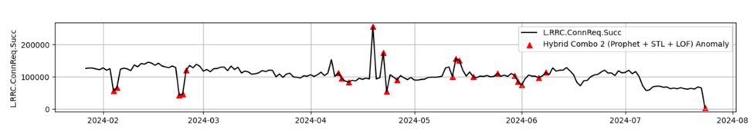
Fusion 2: STL + Z-score + Prophet + LOF

Slide 32
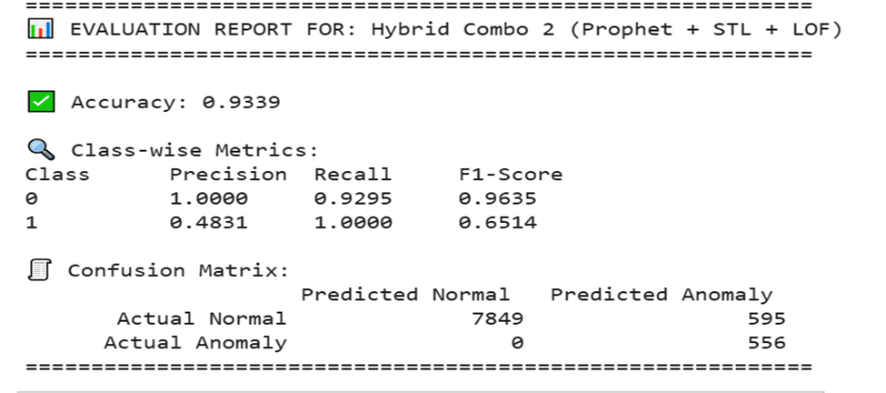
Fusion 2: STL + Z-score + Prophet + LOF

Slide 33
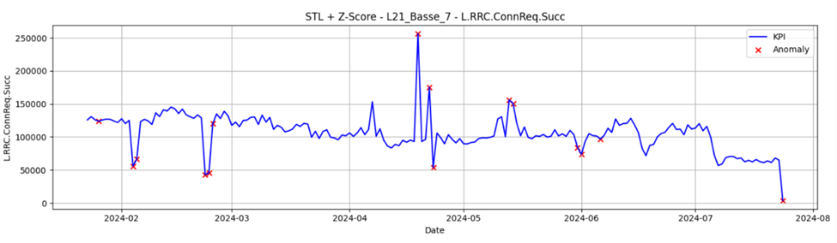
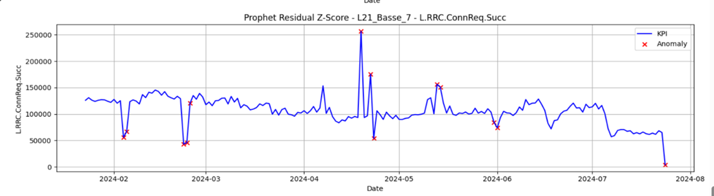
Fusion 3: Prophet (60%) + STL + Z-score (40%)

Slide 34
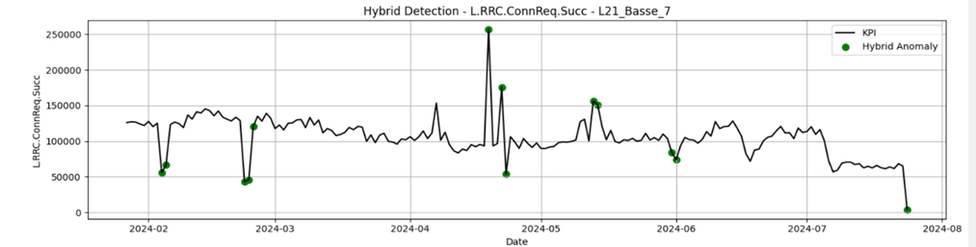
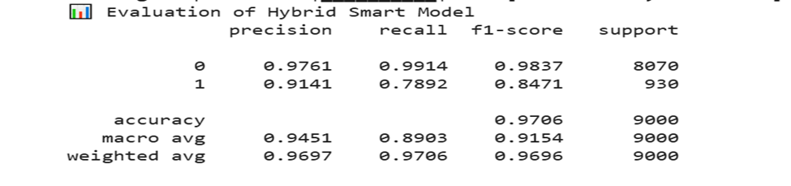
Fusion 3: Prophet (60%) + STL + Z-score (40%)

Slide 35
05
LLM Summary + Geo-Spatial Module

Slide 36
LLM Summary Function:
From Data to Insight
Purpose: Automatically summarizes anomaly results for quick decision-making
Tech Stack:OpenRouter API, Mistral-7B , LangChain, Streamlit
Output: Executive-friendly, plain-language reports & recommendations
Notes:
Converts complex anomaly data to actionable insights

Slide 37
LLM Summary Output
Raw anomaly logs → LLM summary (easy to interpret)
Example:
"Cell X experienced high traffic anomalies on July 3, 2024; Recommend
increasing monitoring and alerting field team."
Reduces the need for expert interpretation
Notes:
Replace this with a real screenshot if available.

Slide 38
Geo-Spatial Module:
Mapping Anomalies
• Purpose: Visualize anomalies geographically for fast pattern recognition
• Tech Stack: Folium, Plotly, Pandas, Streamlit
• Features: Regional filtering, spatial clustering, interactive map
Notes:
Visualizes anomalies by site/region on interactive maps
Seamlessly integrated in anomaly detection pipeline

Slide 39
Geo-Spatial Output
Anomalies shown on a map with color-coded markers
Filter by region, cell, or frequency band
Quickly spot problem clusters or high-impact regions
Notes:
Replace this with your real map screenshot if possible.

Slide 40
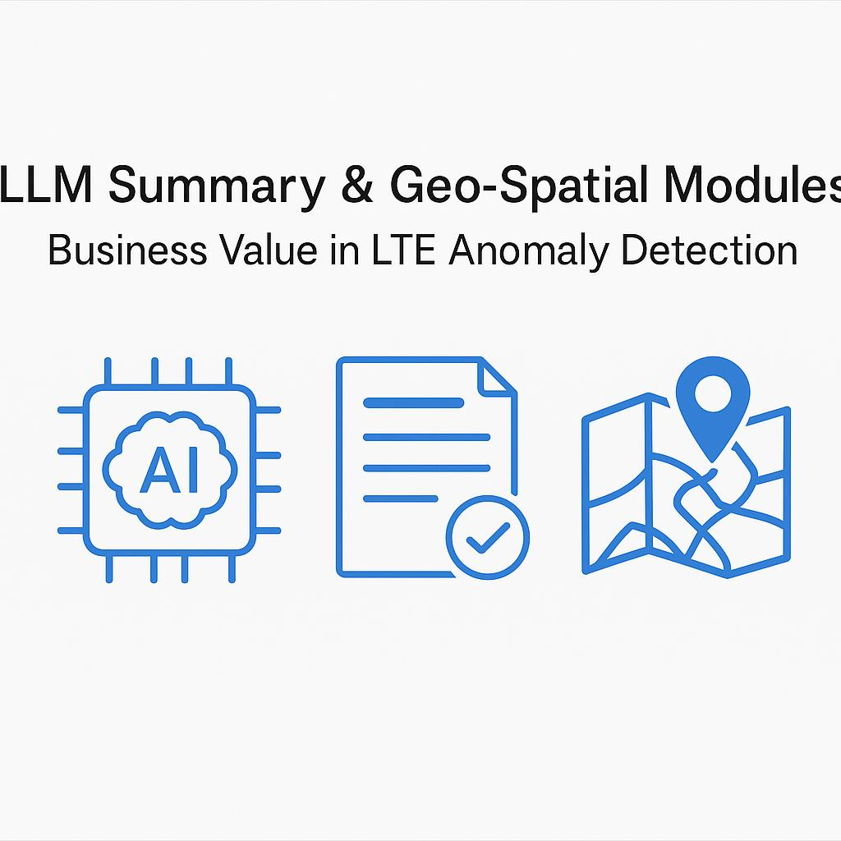
Business Impact
Faster anomaly detection & resolution
Proactive network management (less downtime, improved customer experience)
Easy, automated reporting for management
Improved field team coordination and response
Quantified value: e.g., 30% reduction in investigation time

Slide 41
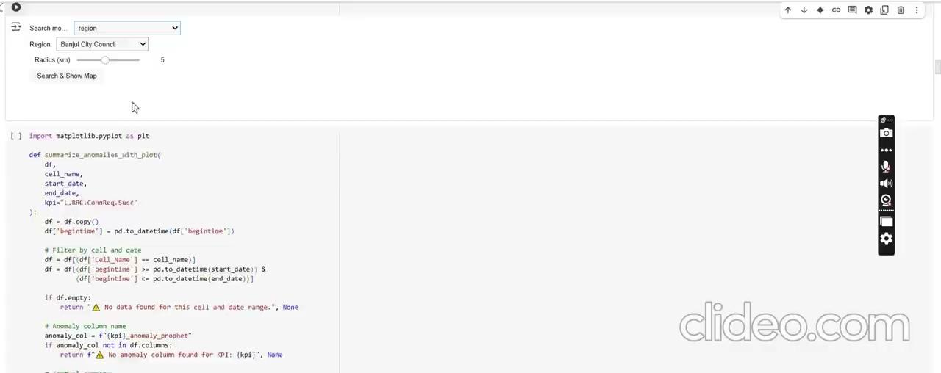
Module C:

Slide 42
06
NetVision

Slide 46
NetVision :
fully interactive LTE anomaly detection dashboard
support real-time telecom network analysis for 4G LTE cells and KPIs
It combines data science, machine learning, LLMs, and interactive geospatial mapping in one place

Slide 47
NetVision :
1. LLM Summary Page
2. Compare KPIs Page
3. Geo-Search Page

Slide 48
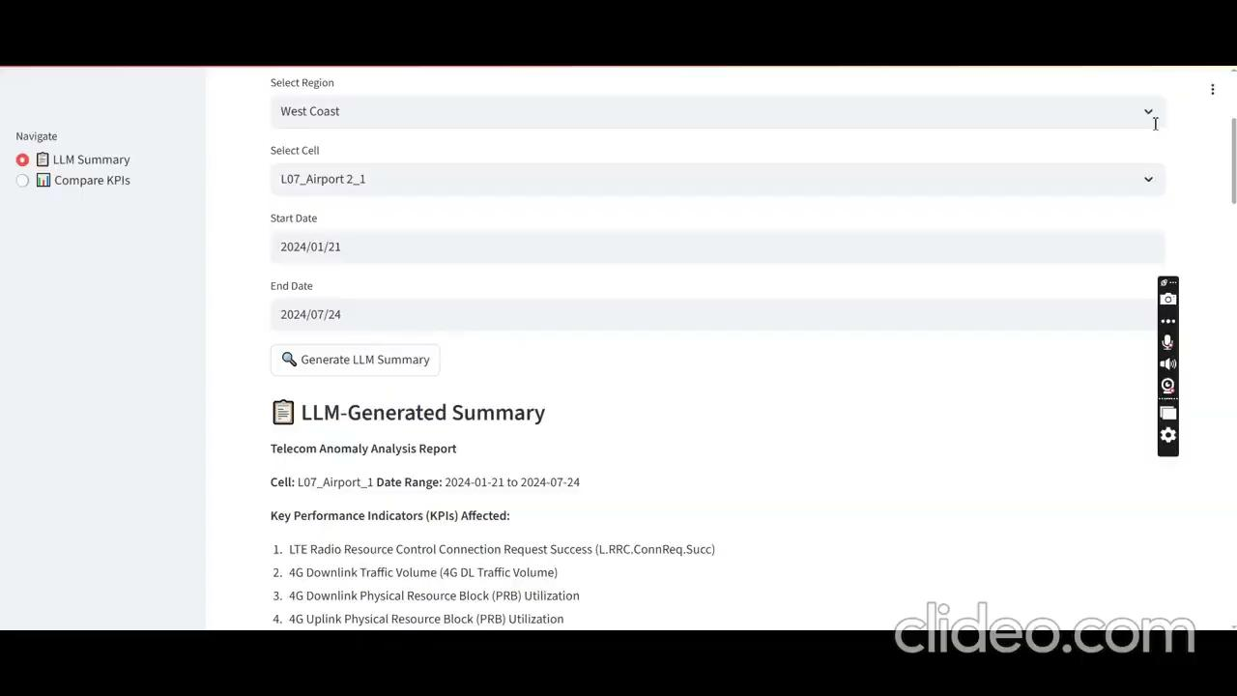
NetVision :

Slide 49


REFERENCE
Nixtla Time Series :
https://bit.ly/nixtla-anomaly
Prophet Detection :
https://bit.ly/prophet-outlier
Observable Demo Notebook:
https://bit.ly/observable-anomaly

Slide 50


CONTACT US

Slide 51


Slide 52

THANK YOU

